Slide 1
Week 3
The Bible: God’s Love Letter to Humanity
Keith & Yvonne Fredlake
fredlake@disciples.com

Slide 2
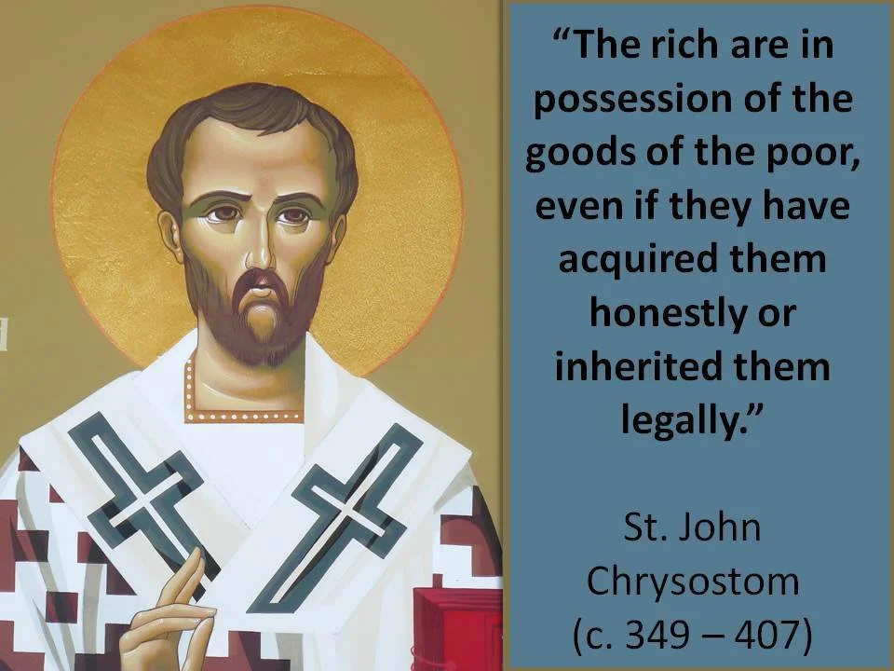
Opening Prayer
O Lord Jesus Christ, open the eyes of my heart, that I may hear your word and understand and do your will, for I am a sojourner upon the earth. Hide not your commandments from me, but open my eyes, that I may perceive the wonders of your law. Speak unto me the hidden and secret things of your wisdom. On you do I set my hope, O my God, that you shall enlighten my mind and understanding with the light of your knowledge, not only to cherish those things which are written, but to do them; that in reading the lives and sayings of the saints I may not sin, but that such may serve for my restoration, enlightenment, and sanctification, for the salvation of my soul, and the inheritance of life everlasting. For you are the enlightenment of those who lie in darkness, and from you comes every good deed and every gift. Amen.
-St. John Crysostom

Slide 3
Weekly Review
Prayer requests
Share successes
Address concerns
Acknowledge celebrations

Slide 4
Scripture Reflection
Your word is a lamp to my feet and a light to my path.
Psalm 119:105
The Bible is the written word of God meant to help us know God and His plan for our lives.
Jesus is the Word made flesh who came to help us to know God more fully, to be a role model for moral living, and to bring salvation to mankind.
How has the word of God been a light to your life?

Slide 5

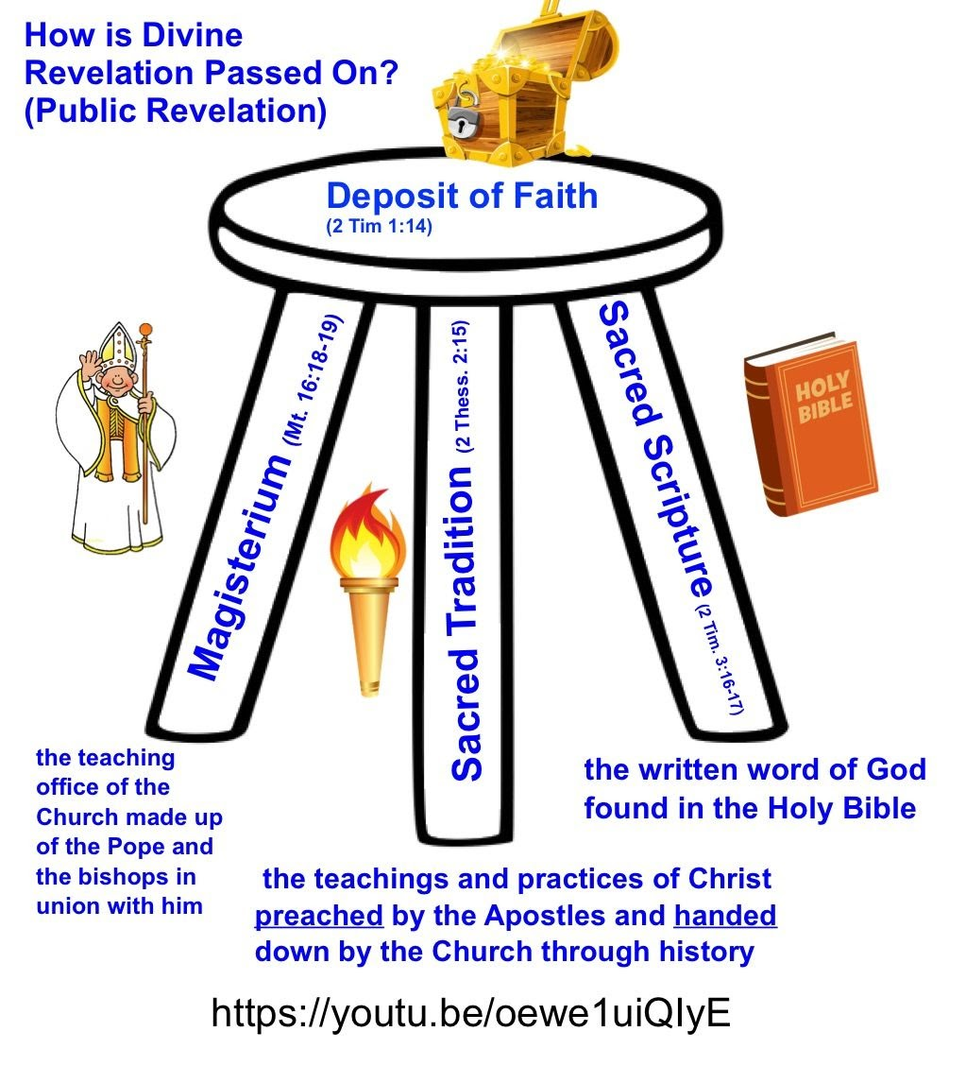
Bibles for Children
Sacred Scripture

Slide 6
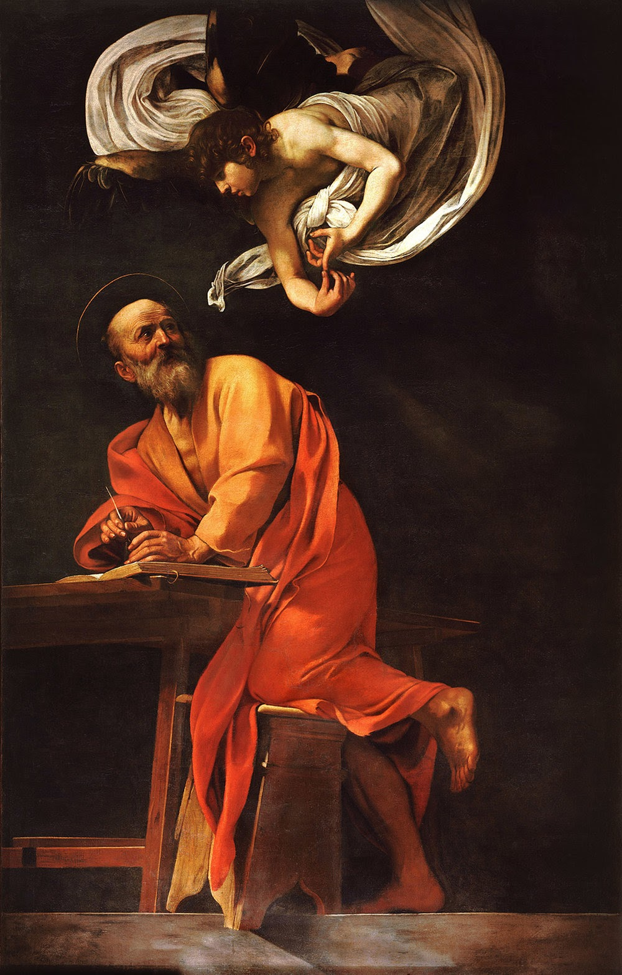
Who are the authors of the bible?
It is inspired by God and written by human authors.
Inspired by God literally means God breathes His Word to man.
God actively communicates with man through His Word.
He reaches out to man to reveal Himself to us.

Slide 7
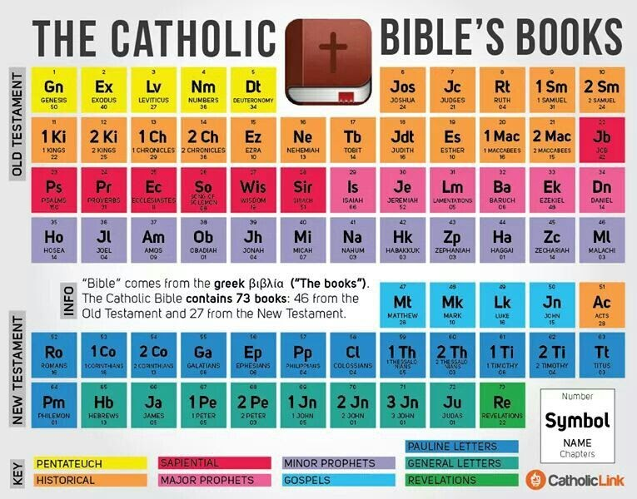
Catholic Church has the biggest bible!
Books are organized in different categories
Canon = list
First list recorded in 382 AD from Synod of Rome
Hippo (393) and Carthage (419) Councils voted to ratify the list

Slide 8
How to make a list? (Criteria for Canon)
True- does it match with the teachings of Christ?
Universal- is it appropriate for all people in all ages?
Liturgical - has it been in use in the liturgy of the Church since 1st century?
Apostolic- written by an apostle or one of his colleagues?

Slide 9
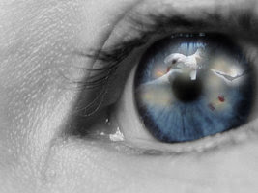
How to read?
Literal
Song of Songs 4:1-2
Literally – Intent to communicate
How beautiful you are, my darling!
Oh, how beautiful!
Your eyes behind your veil are doves.
Your hair is like a flock of goats
descending from the hills of Gilead.
Your teeth are like a flock of sheep just shorn,
coming up from the washing.
Dove eyes can only focus on one thing at a time.
What about goats?
What about sheep?

Slide 10
Prayers
Angel of God,
My guardian dear,
to whom God’s love commits me here,
ever this day be at my side,
to light and guard, to rule and guide.
Amen.
Sign of Cross
Angel of God

Slide 11
Feast of Michael, Raphael, and Gabriel
Angels—messengers from God—appear frequently in Scripture, but only Michael, Gabriel and Raphael are named.
Michael (Jude, Daniel and Book of Revelation)
Gabriel (Daniel and Luke)
Raphael’s (Tobit)
Find these stories in the Bible.

Slide 12
1st and 2nd Graders Highlights
The Bible is a gift from God.
The Bible helps us to learn more about God so that we can love Him and know how to please Him; We cannot love what we do not know.
There are 2 main parts: the Old Testament and the New Testament.
The Old Testament tells about the people who were waiting for the Savior.
The New Testament tells about the life of Jesus and the beginning of the Catholic Church.

Slide 13
1st and 2nd Graders Activities
Prayers
First Grader Craft Project
Second Graders:
Complete Spirit of Truth (pages 11-18). Turn in these pages at the end of the month.
Complete September assessment K-2 - September Monthly Assessment K-2nd

Slide 14
3rd - 6th Graders Highlights
The Bible has 2 authors: Divine and Human.
The Old Testament begins with creation and goes up to close to the birth of Jesus Christ.
The New Testament opens with the birth of Jesus Christ.
The books in the Old Testament were written by people waiting for the Savior.
The books of the New Testament were written by people who knew Jesus personally or knew one of the apostles personally.
The Bible is His Story and God wants to tell His Story to us.
BIBLE-
Basic
Instructions
Before
Leaving
Earth

Slide 15
3rd - 6th Graders Activities
Ask your child to tell you what a night light or a flashlight is for. Tell them that in the Bible (Psalm 119:105) the Bible is described as a lamp. Ask them how can a book be a lamp? What are some of its characteristics?
Find the Archangels in the Bible
Read the parable of the Good Samaritan (Luke 10:25-37). Ask your child to retell the story in his/her own words.
Complete September assessment
3-5th September Monthly Assessment 3rd-5th
6-8th September Monthly Assessment 6th-8th

Slide 16
Closing Prayer
A prayer you can use before reading the Bible
We praise you and thank you glorious Lord Jesus Christ, for being present among us and in us. In us you praise the Father with the voice of the Spirit, whom you have given us. Lord, may this voice of the Spirit be roused in us as we listen to the words of Scripture in a manner that is worthy and fitting, appropriate to the meaning of the text and in harmony with what is revealed to us. Make us ready to recognize how we can correspond to the teaching and example proposed to us, for you are God, living and reigning for ever and ever, Amen.
Community Meeting
Sunday Oct. 4, 2020
@ HT (Back lot)
1pm-2pm or
Life Chain
@ BT&T Bank
2pm-3pm

