Slide 1

WELCOME
Divine Revelation:
God Is Seeking Us and Is the Compass for Our Lives
Keith & Yvonne Fredlake
fredlake@disciples.com

Slide 2
Opening Prayer
Father in Heaven, give us the power of your grace that we might always walk in the way you have revealed through your Son, Jesus Christ.
Free us from the darkness of our own desires and bring us into the light of your truth.
Form our lives according to your will, mold our hearts by your love.
And grant that we might always be open and receptive to the guidance of your Church.
We ask this in the name of the One who has promised to be with us always, now and forever. Amen.

Slide 3
History:
It happened when?
LATIN WORD OF THE DAY
Prayer Level
Level | Prayer 1 | Prayer 2
Angel | Sign of the Cross | Guardian Angel
Sanctus, sanctus, sanctus
Holy, holy, holy
What is Arian?
After years of brutalization, Goths rebelled against Rome and defeated Arian Emperor Valens at the Battle of Adrianople.
378 AD

Slide 4
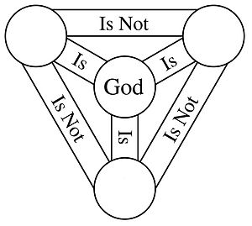
Blessed Trinity
One God –
unity of persons
Are the three persons of the trinity distinct?
Spirit
Son
Three Divine
Persons
Co-eternal –
no beginning, no end
Father
Notes:
The trinity is defined properly not as three people hanging about in one essence, but as three relations. Everything exists in relation to someone or something else. Everything. Faith is a relationship with God. God is a relationship among the three persons of the Trinity. Existence is a relationship among all the creatures and objects and atoms of the material world. Material objects are a relationship among the atoms that comprise them.

Slide 5

Blessed Trinity
Controversy – DRAMA - TRADITION
Christ Crucified
Paul
Peter
John
Justin
Great Persecution
Constantine
Catholic Password
End of Public Revelation
Apologists
Battle at the Bridge
Martyrs – witnesses who
were killed
Confessors – professed the faith but not killed
Traitors – Christians who handed over other Christians
New Testament
Church
Arianism – Son of God Created
by the Father
Trinitarian – Gift of Faith
Lapsi – gave in, did not stand up for Christianity
Notes:
Jesus is the fullness of God’s revelation.
Jesus revealed God’s loving plan of salvation.
Jesus also chose Peter to be the first leader of His Church and gave him the “Keys to the Kingdom.”
The keys are a symbol of authority.
Peter was the first Pope of the Church.
Arianism maintained that the Son of God was created by the Father and was therefore neither coeternal with the Father, nor consubstantial.
Milvian bridge
Catholic Password – Nicene Creed

Slide 6
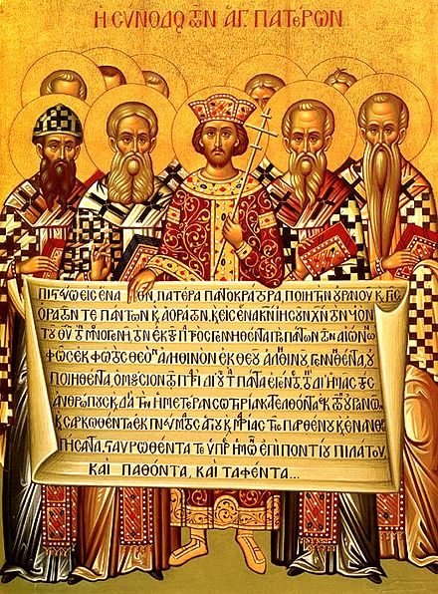
NICENE CREED
I believe in one God,
the Father almighty,
maker of heaven and earth,
of all things visible and invisible.
I believe in one Lord Jesus Christ,
the Only Begotten Son of God,
born of the Father before all ages.
God from God, Light from Light,
true God from true God,
begotten, not made, consubstantial with the Father;
through him all things were made.
For us men and for our salvation
he came down from heaven,
and by the Holy Spirit was incarnate of the Virgin Mary,
and became man.
For our sake he was crucified under Pontius Pilate,
he suffered death and was buried,
and rose again on the third day
in accordance with the Scriptures.
He ascended into heaven
and is seated at the right hand of the Father.
He will come again in glory
to judge the living and the dead
and his kingdom will have no end.
I believe in the Holy Spirit, the Lord, the giver of life,
who proceeds from the Father and the Son,
who with the Father and the Son is adored and glorified,
who has spoken through the prophets.
I believe in one, holy, catholic and apostolic Church.
I confess one Baptism for the forgiveness of sins and I look forward to the resurrection of the dead and the life of the world to come. Amen.
Notes:
When do we say it?
Why do we say it at every mass?

Slide 7
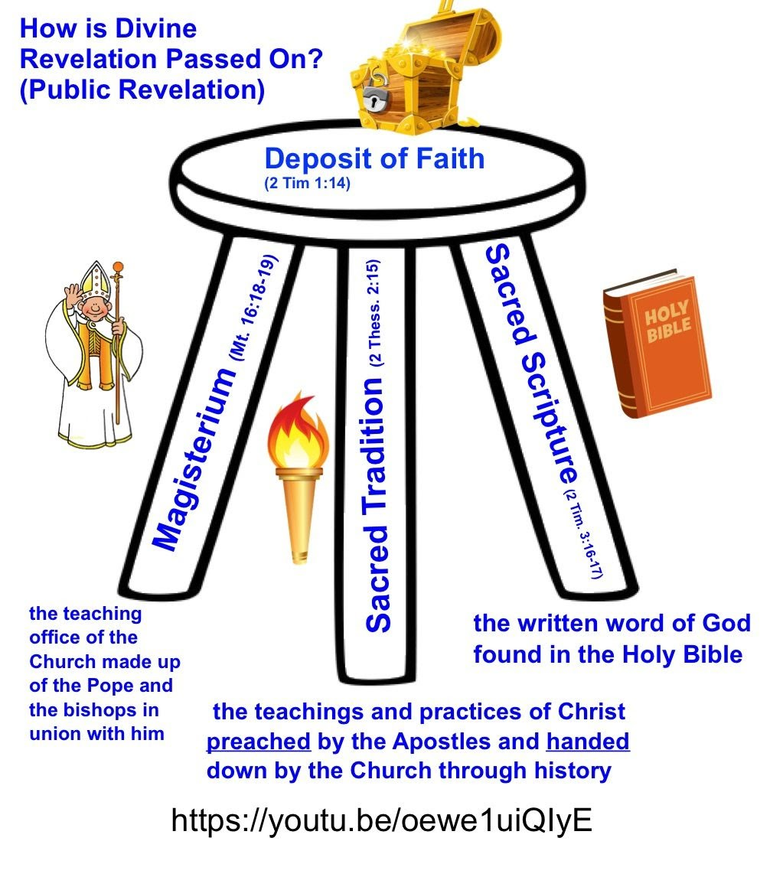
“the Deposit of Faith”
The Revelation of Jesus, all of His teachings that have been handed down either orally or in writing, is called “the Deposit of Faith” and was entrusted by the Apostles to the teaching office of the Church.
This teaching office is called the Magisterium.
The Magisterium is responsible for authentic interpretation of Divine Revelation.

Slide 8
Gospel Preparation
Jack’s Phone
Pete’s Phone
Hey it’s Dad
This is Dad.
SMH; I know
Who else?
I need you to mow the lake, before it rains. Thanks Dad
The lawn needs to be mowed; can you do it?
What?
Yea
Mt: 21-28-32 – Obey God’s Will
“you did not believe him.”
Lawn mow the law
Thanks
Lawn; Why?
NP
Because it is going to rain today
Jesus asks for our opinion on this situation.
I don’t want to; DIY K
Jack later mowed the lawn, while Pete zoned out on YouTube.
Who did what Dad asked?
Avoid Formalism as a Cover-up for Genuine Love and Commitment.

Slide 9
Discussion Questions:
1. What are problems with relying only on the scripture for teachings?
Ignores tradition
Reformers believed that Scripture alone was the only infallible source for revelation
Problem with Protestant religions; unbiblical; unhistorical; unworkable
2. Do the three persons of the trinity have different works?
Yes; Father is creator; Son is Redeemer; and Holy Spirit is Sanctifier
3. Are the three persons of the trinity distinct?
Yes; yet are one "substance, essence or nature"
4. How free is an addict?
Father VW – addict cannot be free- depends on addiction
Freedom allows us to learn what is truly good for us and gives us the confidence to choose it.
Discuss some family rules that are in place to ensure the safety of your family.

Slide 10
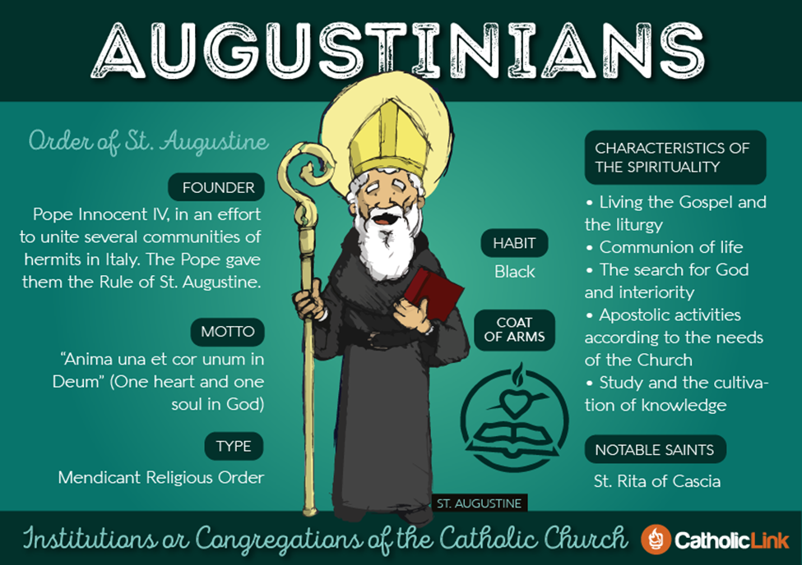
Notes:
Founded in 1244
The opening words of Saint Augustine's Rule give us direction: we are to be of one mind and heart on the way to God. We are travelers on pilgrimage together, wherein Christ is our constant companion, as well as our way and our goal.
Ordo sancti Augustini; abbreviated OSA
Came to America in 1776 to Philadelphia – founded Villanova
open-ended cross suggests the various roads traveled by Augustinians over the centuries to spread the word of God

Slide 11
Closing Prayer
Teach me, O Lord, the way of thy statutes; and I will keep it to the end.
Give me understanding, that I may keep thy law and observe it with my whole heart.
Lead me in the path of thy commandments, for I delight in it….
How sweet are thy words to my taste, sweeter than honey to my mouth!
Through thy precepts I get understanding...Thy word is a lamp to my feet and a light to my path.

