Slide 1

Welcome
The Journey of Faith: Trinity, Faith, and the God Who Is Love
Keith & Yvonne Fredlake
fredlake@disciples.com
Sept. 15 : Our Lady of Sorrows
Notes:
I have NO idea what is going on!!!
No child is in the building
Parents are the educators of their children
Parents watch a 30 min video (on FORMED) and attend a weekly Zoom meeting to get the lessons of the week for all of their children
The lessons are taught in a 4-week cycle: 3 weeks of parent meetings on zoom, one week is a family community building day focused on Catholic culture (no parent meeting that week).
The parents teach the children when it is best for the family.
Every 3 weeks there is a short assessment that the children take to make sure we are all staying on track.

Slide 2

Opening Prayer
O Lord, you have searched me and known me. You know when I sit down and when I rise up; you discern my thoughts from far away.
You search out my path and my lying down, and are acquainted with all my ways.
Even before a word is on my tongue, O Lord, you know it completely.
For it was you who formed my inward parts; you knit me together in my mother’s womb. I praise you, for I am fearfully and wonderfully made.
Notes:
-Psalm 139:1-4, 13-14

Slide 3



Mentor – Catechism
EXTRA
Notes:
Do not expect to know all the answers! It is all right to tell your child that you do not know the answer to the question they are asking but will find out and get back to them. Our faith is extraordinarily rich with teaching and we all are constantly learning on our individual spiritual journeys.
Reach out to your mentor with any questions or concerns you have
Work on this program at your child’s own pace each week.
4 Quite early on, the name catechesis was given to the totality of the Church's efforts to make disciples, to help men believe that Jesus is the Son of God so that believing they might have life in his name, and to educate and instruct them in this life, thus building up the body of Christ.⁷
5 "Catechesis is an education in the faith of children, young people and adults which includes especially the teaching of Christian doctrine imparted, generally speaking, in an organic and systematic way, with a view to initiating the hearers into the fullness of Christian life."⁸
Symbolon is the video you can watch you with student in advance of the class
The zoom is where we share and discuss.
The extra – well it is extra as the kids say. Lots of different ideas to help you and your child. I pull this from textbooks, podcasts, catholic websites and books. Generally this can be summed up as Gospels, Saints, Latin, History, and Dogma.
We can dial up and dial down each of these three tools.

Slide 4

Notes:
There is a line in the first Symbolon video – When a 50 year wants to pray and he had only been taught as a 8 year old, then prayer won’t work. The goal is to create a spark, anything that moves one from where they are to another place.

Slide 5
Catechesis: Life Is A Pilgrimage
What does that mean?
Does that sound exhausting?
Who has taken a pilgrimage?
Where are we going on this pilgrimage?
Notes:
On the Road to Emmaus, the two friends of Jesus did not recognize Him (Luke 24:13-35). Journey about 7 miles – about the time between meals.
They were in His Presence.
They listened to His words.
They found Him compelling.
They did not recognize Him.

Slide 6
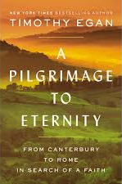
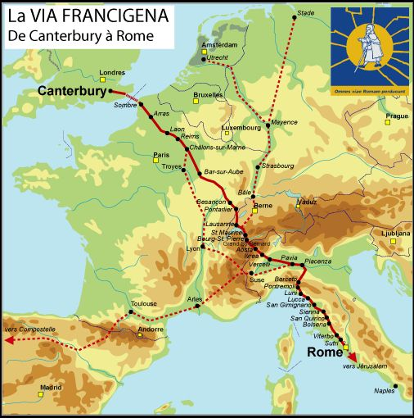
Notes:
Ex-Catholic walk and exploration. Struggles with modern issues, including clergy sex abuse scandals. Not a theologian.
The author remains by choice at quite a distance from Catholicism he continues to be attracted to certain elements of the church's life and theology.
The author seems to need the perfect church. I wonder how he would respond to Father Andrew Greeley (Novelist), who said: "If you can find a perfect church go and join it, but as soon as you do it won't be perfect anymore."

Slide 7
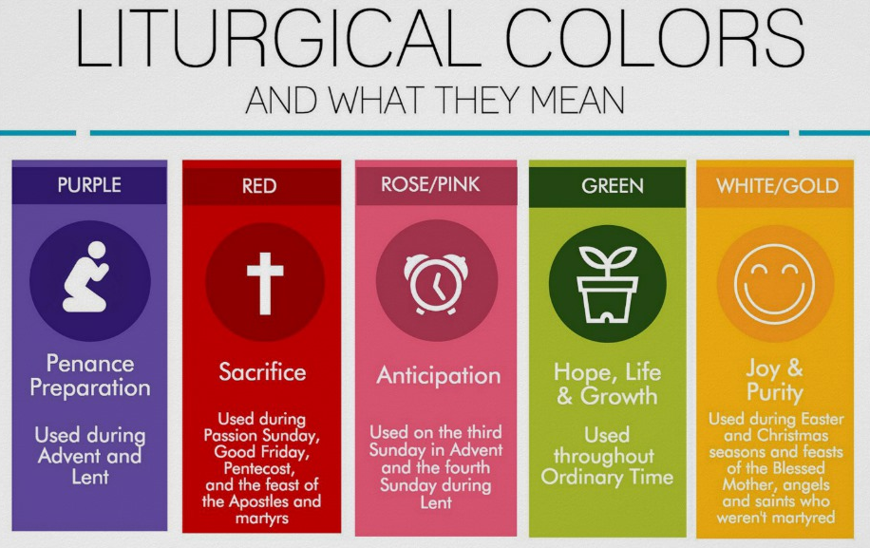
Notes:
Ordinary Time is called "ordinary" not because it is common but simply because the weeks of Ordinary Time are numbered.
Where does a pilgrimage fit – what color?
At every moment of our lives, God draws near to us, calling us to seek Him, to know Him and to love Him.
He invites us through the natural beauty of creation.

Slide 8









Catholic Orders
Carthusians
Benedictines
Dominicans
A charism is essentially the personality of the Order, the attributes and preferences of the founder that determine how they prayer, where and how they live, and what they do in ministry for the Church. A charism can be very specific, tied directly to a particular mission such as teaching or medicine, or can be very general, focused on an ideal like hospitality or mission.
Jesuits
Salesians
Augustinians
Franciscans
Missionaries
of Charity
Carmelites
Notes:
We have lots of differences and different perspectives.
St Paul teaches that this is a grace of the Holy Spirit, freely given to a member or members of the Christian community, to enable them to receive and preach the gospel of Jesus in a particular way, and that every charism enhances the Church’s shared capacity for the service of the Gospel
I offer this as a simple definition: charism is a gift from God for the church and the world, given as different ways of living out the Gospel. In living out religious life one usually chooses a charism.
It is often said that charism is “caught” rather than “taught”.
Charisms have given them a story to join, a community of mission to which to belong, a work to do, a way to pray, face of God to see. They have been built around inspired and inspirational people, indeed saints. They have grown into rich and wise schools of spirituality. These charisms are treasures of the Church; they are the Spirit alive in the Church.
Symbolon is by the Augustinians.
The reason to understand that we need to learn about others learn through the faith. The other reasons is so that you will understood my jokes.
A Franciscan gets a haircut, and then asks how much he owes. The barber says he never charges clergy. The Franciscan thanks the barber and goes home. The next morning the barber finds a big basket of fresh bread from the Franciscans’ kitchens.
An Augustinian gets his hair cut by the same barber. The barber also tells him than he never charges clergy. The next day the barber receives a nice bottle of wine from the Augustinians’ wine cellar.
A Jesuit gets his haircut, and the barber again says that he never charges clergy. The next day, when the barber opens his shop, there are twelve other Jesuits already waiting for him.

Slide 9

Class Moto
may you live in God
Notes:
Inscribed on the Ring of Silvianus - SENICIANE VIVAS IIN DE

Slide 10
History:
It happened when?
LATIN WORD OF THE DAY
Oremus
Theodoric, son of Theodemir king of the Ostrogoths, was taken hostage in Constantinople to secure payment of 300 lbs of gold a year that Theodemir owed the Byzantine Emperor Leo.
Let us pray
461 AD
Notes:
Odoacer deposed emperor in 476 – insignia sent to eastern empire. Odoacer was a Visigoth (Spain). Theodoric was a Ostrogothhic (Bulguria)
Zeno – emperor of Byzantine empire – sought to play the goths against each other. Zeno encouraged Theodoric to invade northern Italy because Theodoric was seeking more lands for his people and going east to Byzantian empire.
Later attacked Odoacer who defeated the Roman Emperor and after a truce - killed him at a dinner in Ravenna 493
Theodoric (Arian – non-Trinitarian)

Slide 11
Prayer Level
Words To Know
From Angel to Seraphim
Find and define each word:
Each level has prayers that needs to be complete to move on.
1. Write the prayer in a notebook.
2. Use the prayer
3. Commit to the prayer
Magisterium
Infallibility
Monstrance
Charism
Piety
Level | Prayer 1 | Prayer 2
Angel | Sign of the Cross | Guardian Angel

Slide 12
Discussion Questions
Suggested
1. What is required for a pilgrimage?
Hope/Struggle/Discipline/Community
Are we ready to commit to a spiritual journey?
2. How does God reveal himself to man?
Community of Person – Trinity
3. What are attributes of God?
All loving/merciful/knowing; unchangeable; infinite; eternal; omnipotent; omnipresent
4. What is the greatest conceivable thing?
God
What is greater—a God who loves everyone who loves him back, or a God who loves everyone unconditionally?
5. What is the Catholic “password”?

Slide 13

Gospel Preparation
Mt. 20:1-16 - “Last shall be first, first shall be last.”
Effort = reward

Slide 14
Logic thinking
1. Draw a straight line.
2. Draw a longer line.
3. Can you draw a straight line longer than any other line?
Notes:
Can you think as God does?
Reflect on the Gospel from Matthew upcoming this week – conflict between human reasoning and God. Humans cannot think like God, and tendency is to get mad at God’s reasoning because it does not match our thinking.
Until you can draw a line longer than any other line, then you will need God’s grace. This is normal, we are humans in need of God’s grace.

Slide 15
Logic thinking
1. Draw a circle
2. Did any one draw this:
3. How many circles must you draw before you draw a square?
4. Cannot prove a squared circle exists by empirical facts.

Slide 16
Logic thinking: Ontological
the concept of God imply that God exists.
God's existence from the very definition of God
self-contradictory to deny that there exists a greatest possible being
Understanding
Reality
Notes:
what is the greatest conceivable thing?
What is greater—a God who loves everyone who loves him back, or a God who loves everyone unconditionally?
very idea of God necessitates his existence.
God is the greatest conceivable thing.
But if something is only in the mind and not in reality, then a greater thing can be conceived.
So, God cannot only be in the mind.
Therefore, God exists in reality.
God + the world” is not greater than God alone
Comparisons of God to the tooth fairy or Santa Claus are often flippantly made, particularly among the New Atheist types. Pathetic as such caricatures are, they betray a conception among non-believers that God is a finite creature. But for St. Anselm, that is precisely what God is not.

Slide 17
Closing Prayer
The Lord is my shepherd, there is nothing I lack.
In green pastures he makes me lie down; to still waters he leads me; He restores my soul.
He guides me along right paths for the sake of his name.
Even though I walk through the valley of the shadow of death, I will fear no evil, for you are with me; your rod and your staff will comfort me.
You set a table before me in front of my enemies; You anoint my head with oil; my cup overflows.
Indeed, goodness and mercy will pursue me all the days of my life; I will dwell in the house of the Lord for endless days.
Notes:
Psalm 23:1-6

